Slide 1

WASSERSTOFF
AI INTERN TASK
ADVANCED IMAGE PROCESSING PIPELINE
SEGMENTATION, IDENTIFICATION, AND ANALYSIS
SONAL RAJ

Slide 2



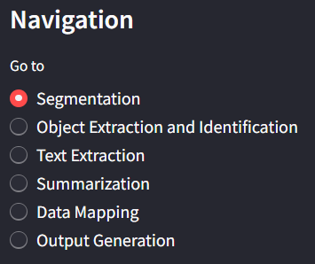




OVERVIEW OF THE PIPELINE
Image Segmentation
Object Extraction and Identification
Text Extraction
Summarization
Data Mapping
Output Generation

Slide 3


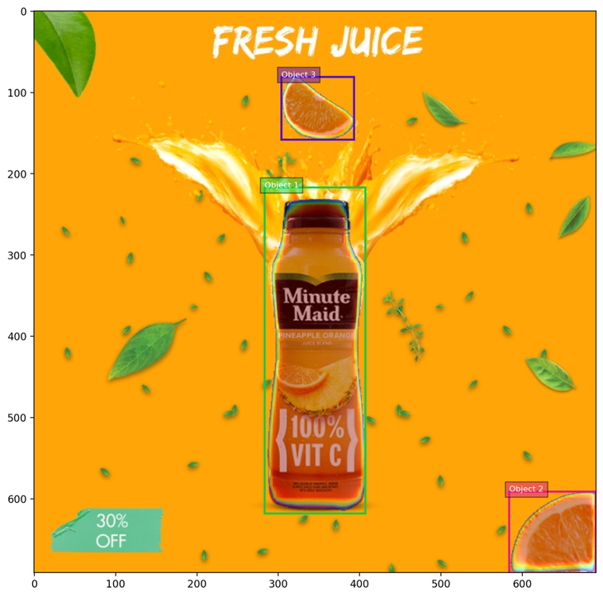


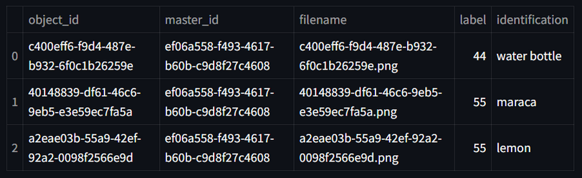


IMAGE SEGMENTATION
OBJECT EXTRACTION
I
UPLOAD IMAGE
I
UPLOAD IMAGE
O
SEGMENTED IMAGE
O
UNIQUE EXTRACTED IMAGES
O
TABLE

Slide 4


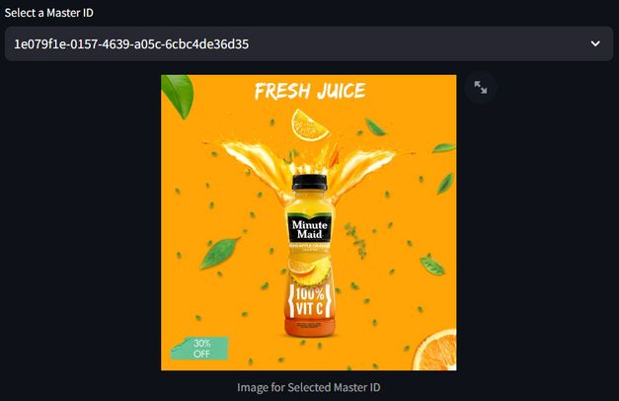








TEXT EXTRACTION
1. Select one master Id --> It will show image linked to that master Id
2. Click On Extract Text
3. Output will be extracted Text From Image

Slide 5


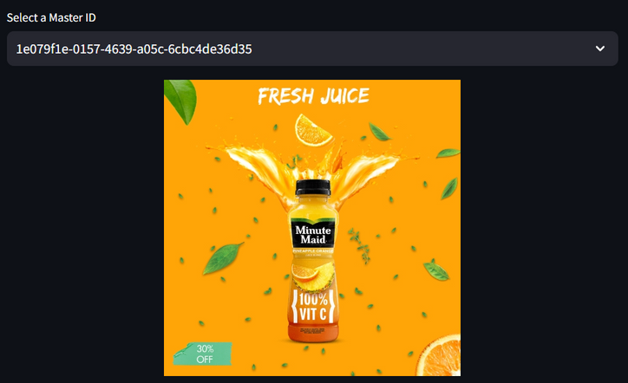



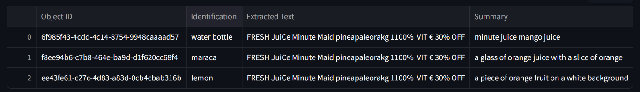
SUMMARIZATION
1. Select one master Id -> It will show image linked to that master Id
2. Click On Extract Text
3. Output will be a Table with Object Id, Identification, Extracted Text & Summary (Predicted Caption) for each segmented object

Slide 6


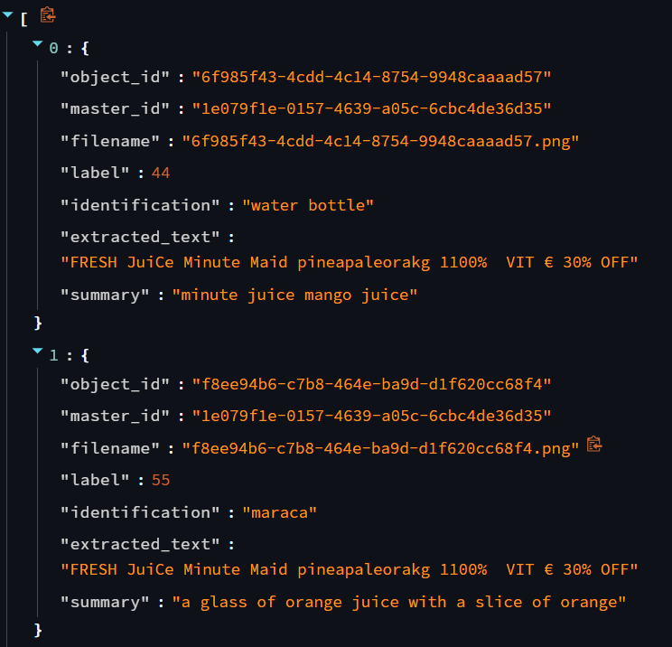

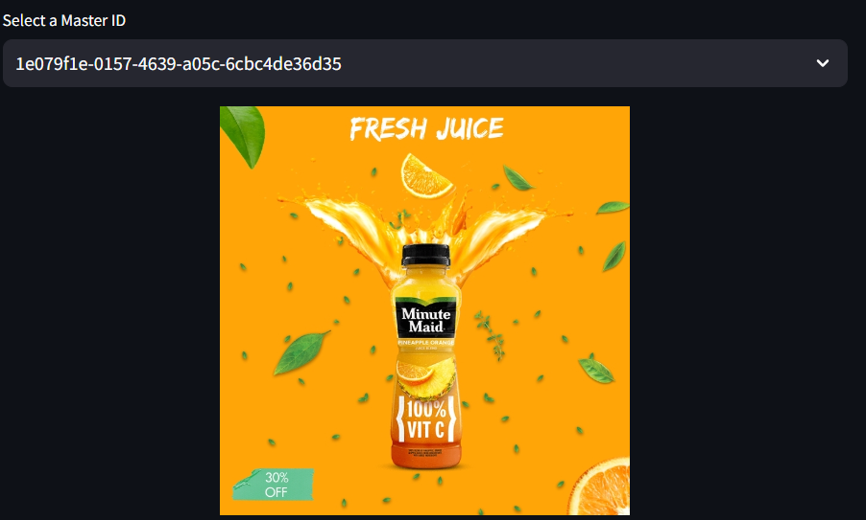

DATA MAPPING
Output will be in JSON containing all Key : Values
Select the master Id and click on Map Data

Slide 7

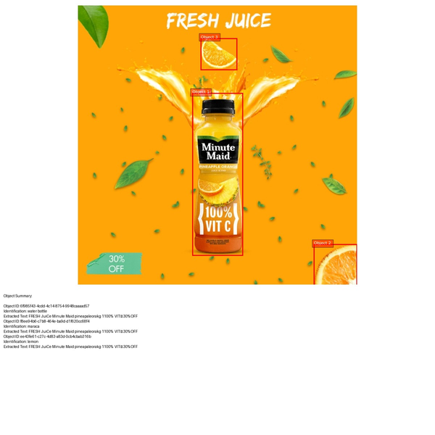

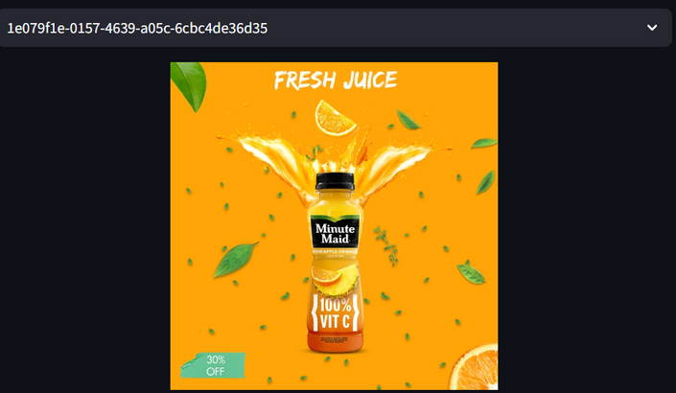
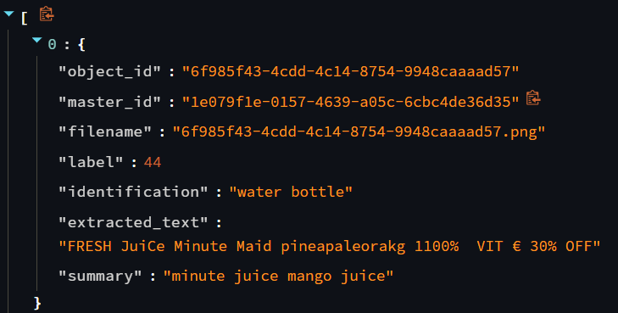
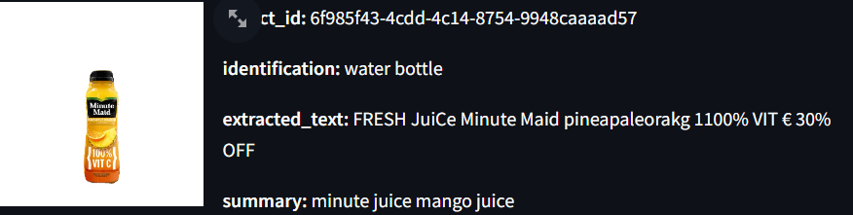
OUTPUT GENERATION
Annotated Image With all details
Select the master Id and click on Map Data
Mapped Data in
JSON Format
Summery Table

Slide 8
THANK YOU!!

